Slide 1
Cardio vascular Disease dataset Rashid Ali Alsumaydi

Slide 2
Introduction My Data Set About Cardiovascular Disease dataset It contains ten columns and seventy thousand rows i Do Some Data Anaalysis

Slide 3
Tools: Pandas numpy seaborn matplotlib Jupyter Power Point

Slide 4
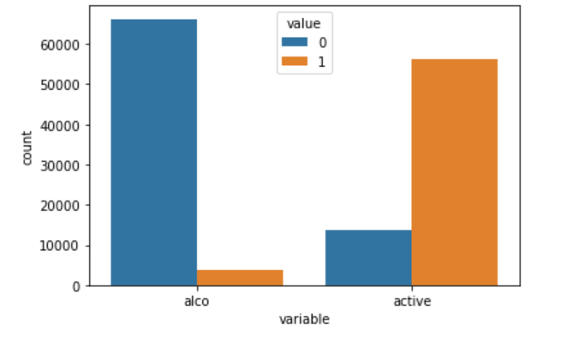
overview
An overview of the activity and glucose levels in the body

Slide 5
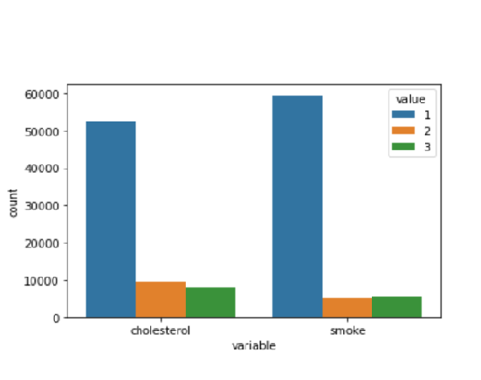
overview of the activity and glucose levels in the body

Slide 6
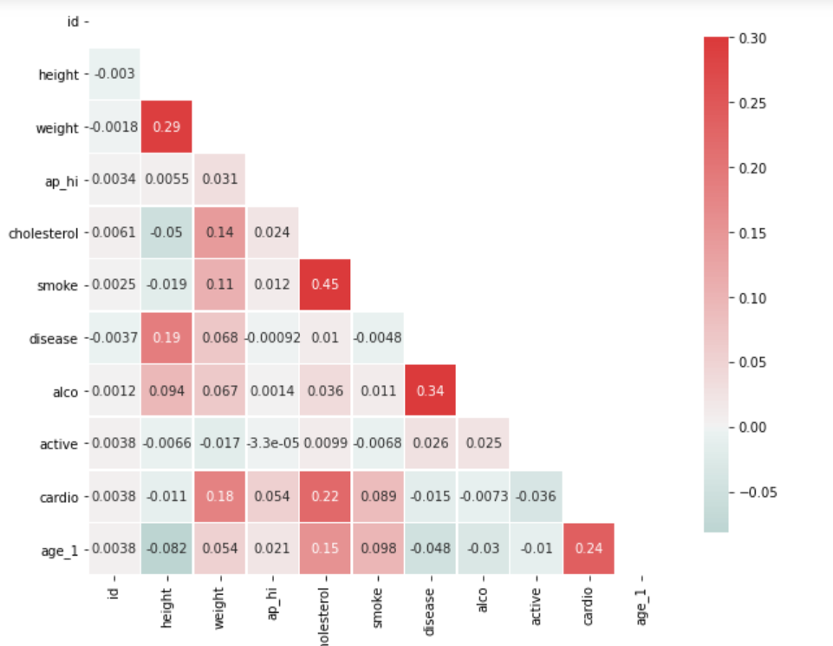
Find Coloration

Slide 7
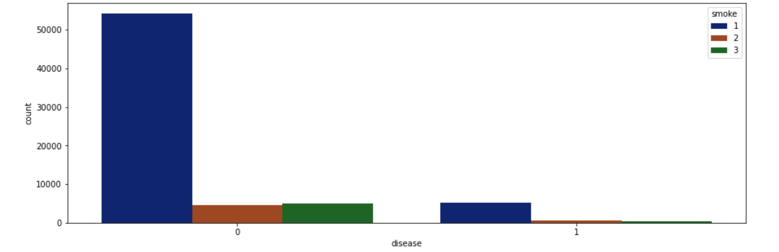
Is there a Relationship between smoke and Disease?

Slide 8
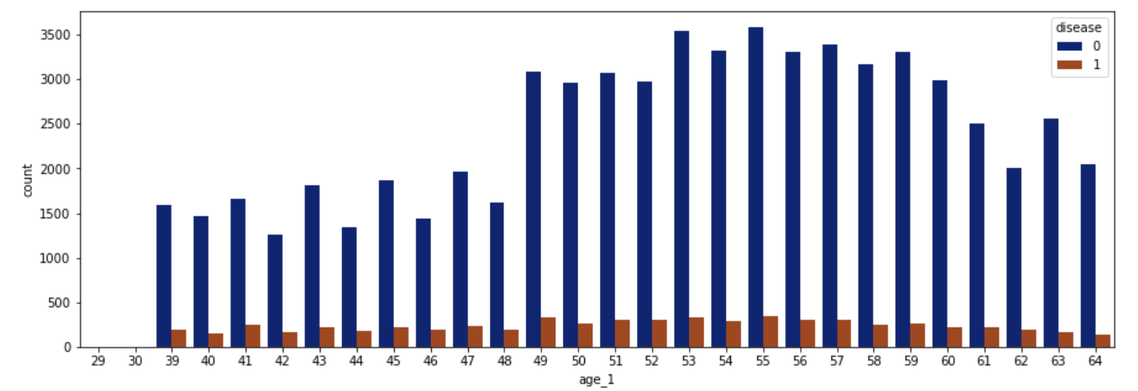
Is there a connection between Age and Disease?

Slide 9
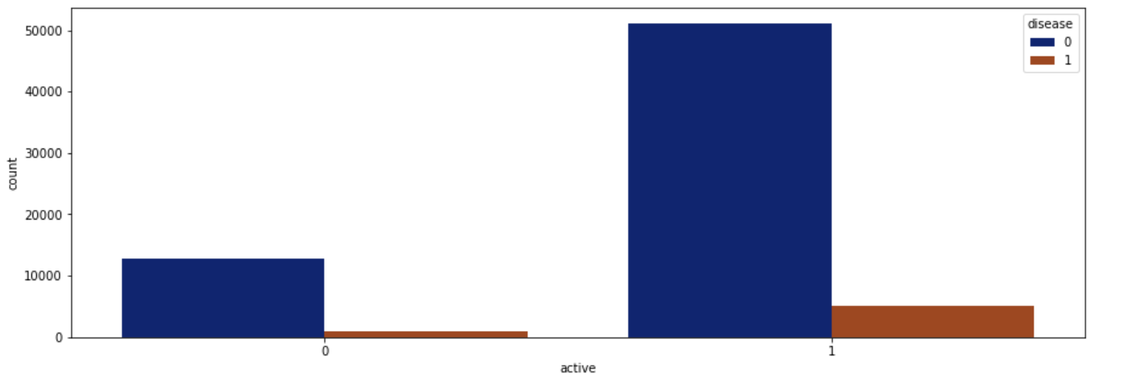
Is there a relationship between physical activity and disease?

